Slide 1



Thermal mapping of sanitary and illegal landfills and estimation of the amount of deposited waste
Training 2
Authors:
Dejan Blagojevic, Aleksandra Boričić, Boban Cvetanovic- AATPS,
Filip Kokalj, Niko Samec UNI Maribor,
Mitko Kostov, Gordana Janevska, Stojanče Nusev, UKLO
Ljiljana Kostić Despotović JugoImpex,
Angelina Petrevska- MZT
Ljubiša Garić, FTN Kosovska Mitrovica UniP
Development of green energy competences for energy stability
ID KA220-HED-E683AE00

Slide 2
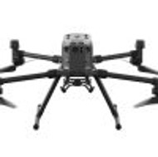
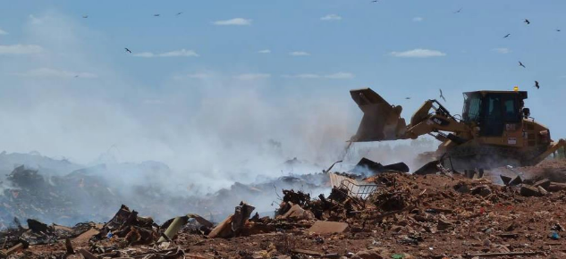
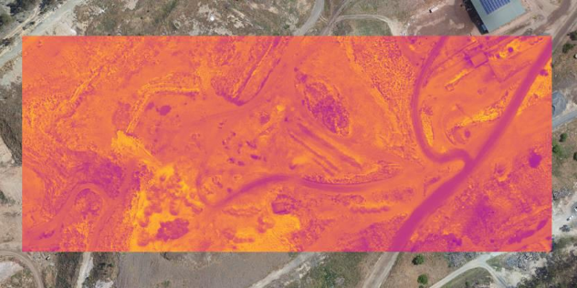
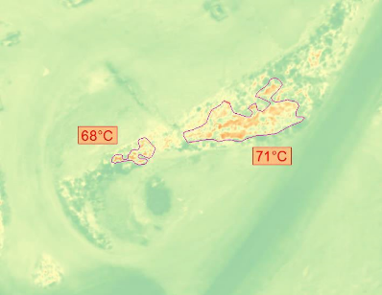
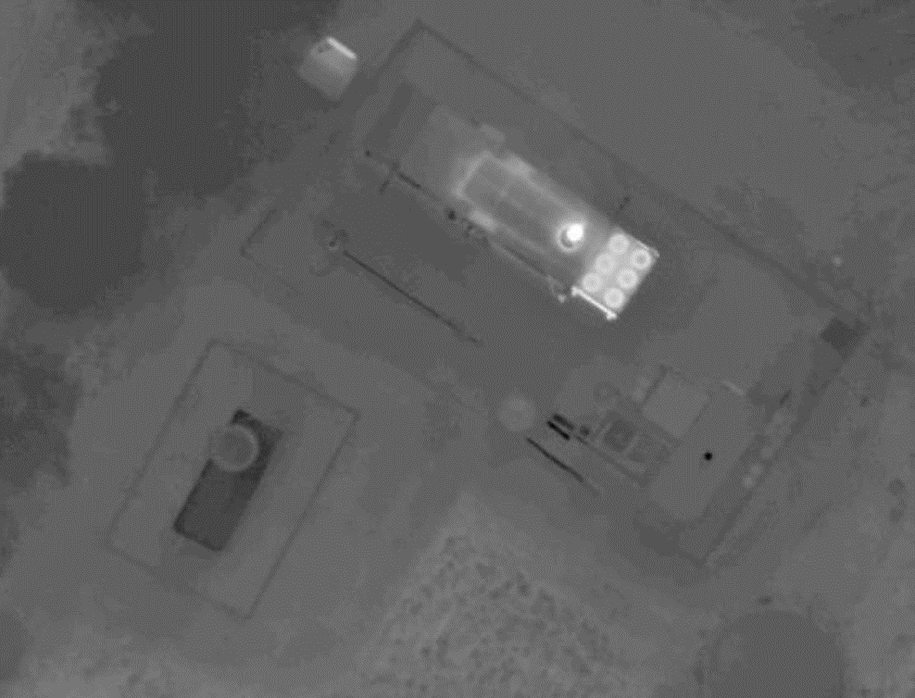

overview
The state of the landfill
Defining Critical Hot Spots
Indicators
3D Mapping
Thermal mapping
Estimate quantity
Fire and Environmental Protection Measures

Slide 3
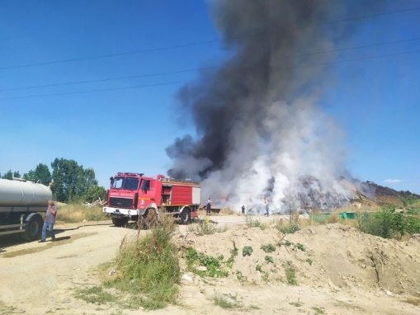
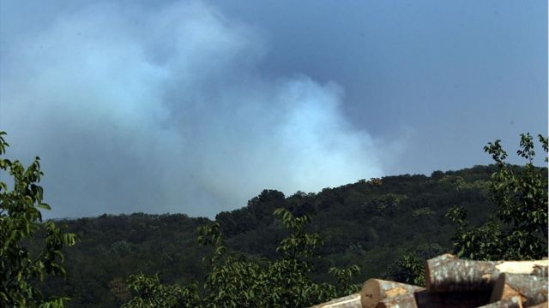
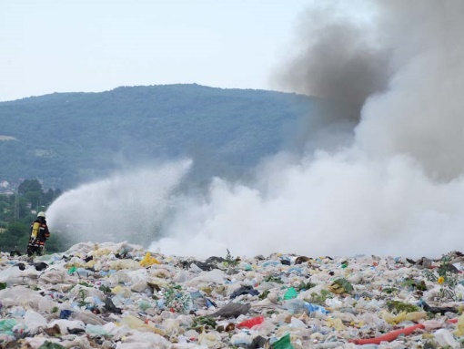
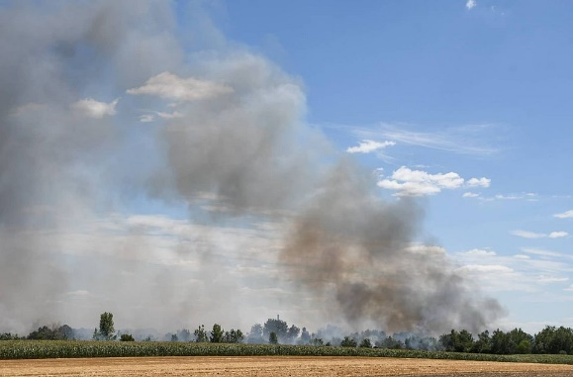
News
Valjevo (July 2022)
Kać july 2022
Vinča August 2021
Jagodina June 2021

Slide 4

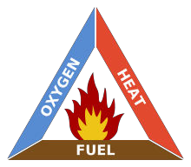
What's the hot spot?
Areas of elevated temperature in the landfill that indicate spontaneous combustion processes below the surface
(<5m from the surface)
(>5m from the surface)
''Triangle of Fire''
Heat – the decomposition of matter or
''Triangle of Fire''
Heat – the decomposition of matter or
''Triangle of Fire''
Heat – the decomposition of matter or
''Triangle of Fire''
Heat – the decomposition of matter or
Spontaneous combustion

Slide 5

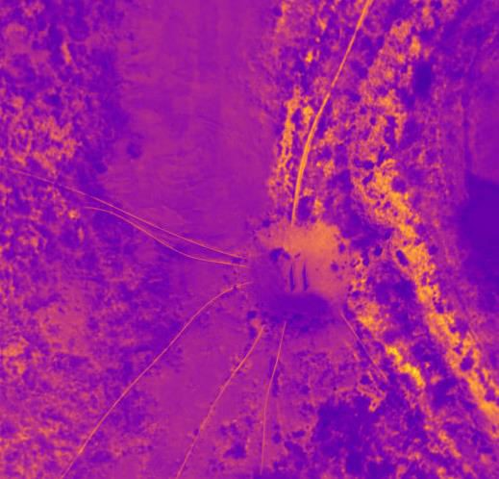
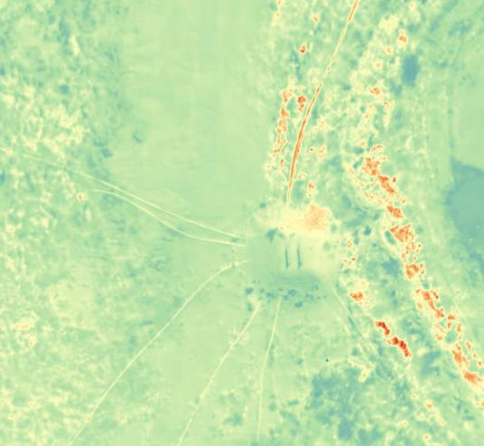
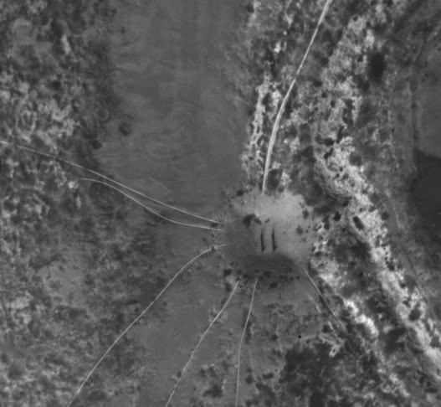
Indicators of ''hot spots''
Smoke, Vapor
Increased surface temperatures
Areas of increased smoldering odor
Elevated levels of carbon monoxide (CO)
Increased gas extraction temperatures
Increased leachate temperatures
Hot leachate or gas wells
Chad in extraction wells / risers
State of vegetation

Slide 6

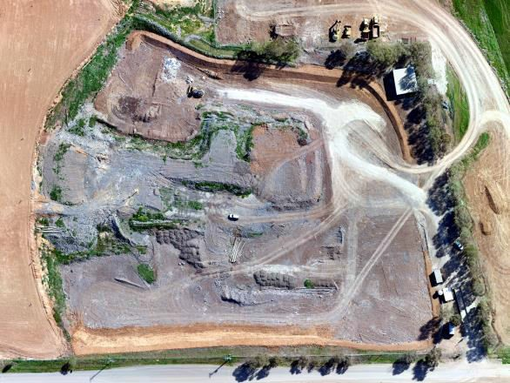
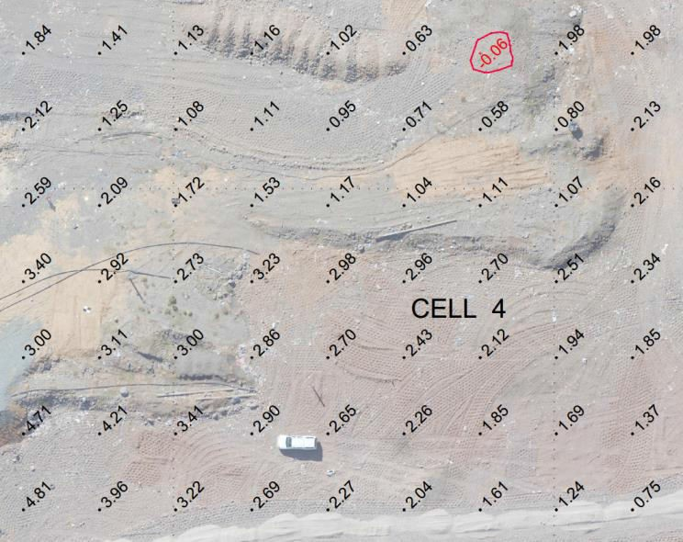
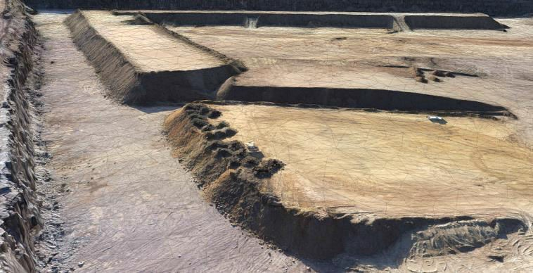
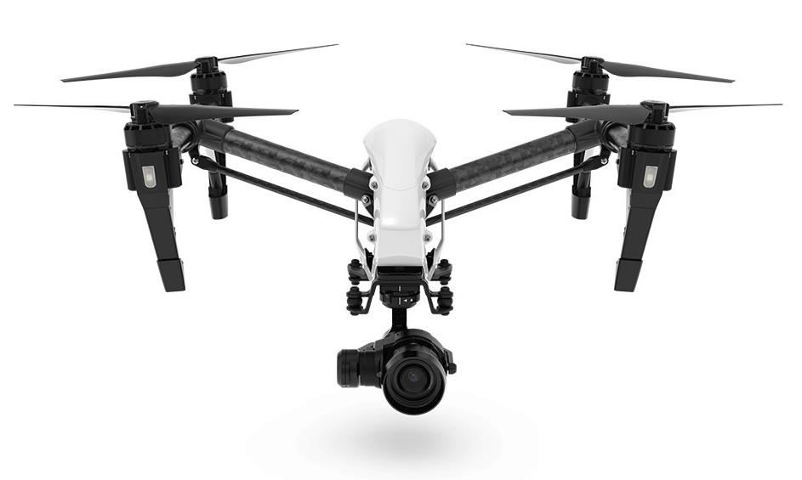
SURVEILLANCE USING UNMANNED AERIAL VEHICLES
Vizuelna inspekcija i nadzor
Kontrola količina odloženog otpada na deponiji
Izrada Digitalnog modela terena
Termalna inspekcija i nadzor
Termalno mapiranje
Inspekcija LIDAR-om
Izrada interaktivnih mapa

Slide 7
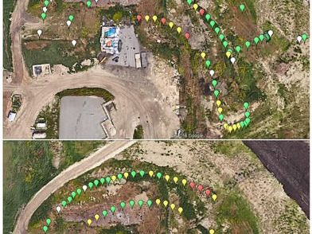
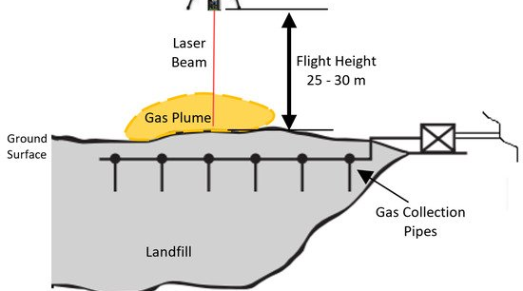
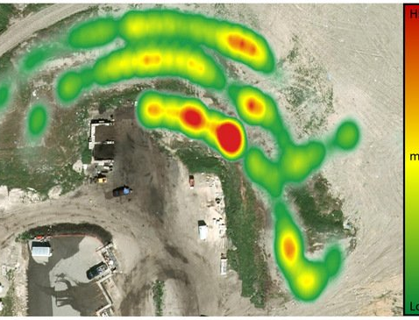

Slide 8


Why thermal inspection?
Contactless
Possibility of further processing and analysis
Reliable
Fast and economical
It's a great initial tool
This Photo by Unknown author is licensed under CC BY-ND.

Slide 9
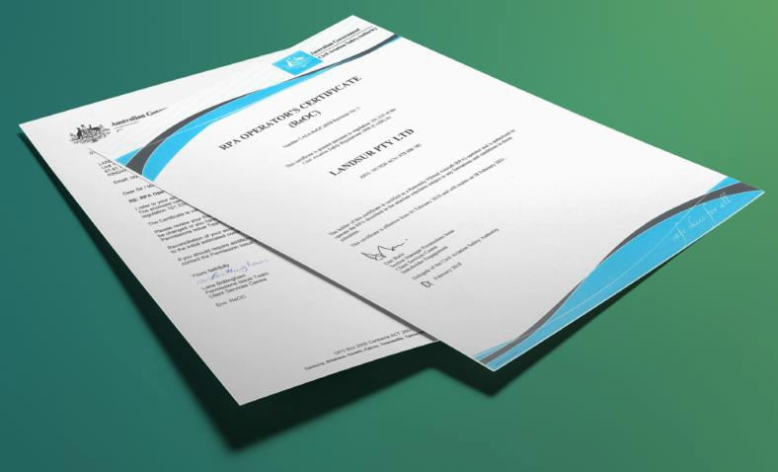

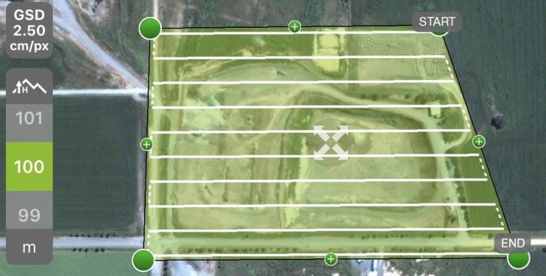
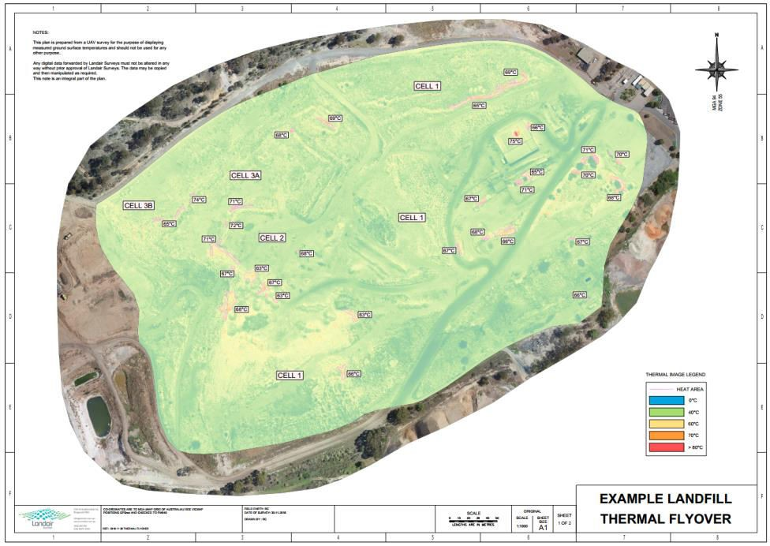
Process
Mission Planning and Legal Framework
Create separate RGB and RJEDG shots
Processing of recordings
Production of RGB&Thermal orotphoto mosaics
Defining "Critical Points" and Analyzing Them
Izrada Interactive Maps
Preparation of reports

Slide 10



Constraints
<5m from the surface
Weather conditions

Slide 11
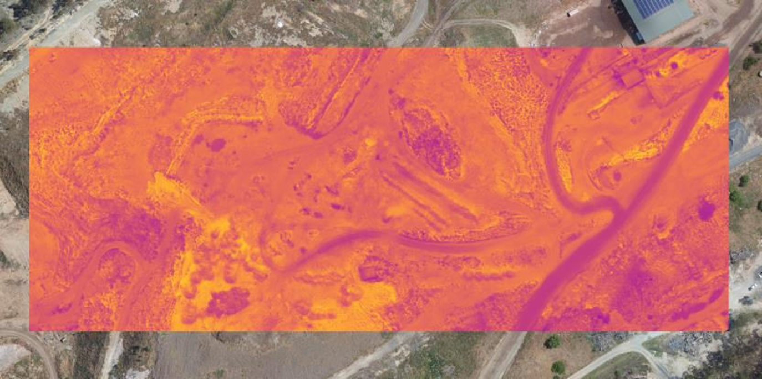
Other Applications of IR Technology
Gas emissions
Gas Infrastructure Monitoring
The state of organic matter

Slide 12

Estimate the amount of waste in landfills

Slide 13
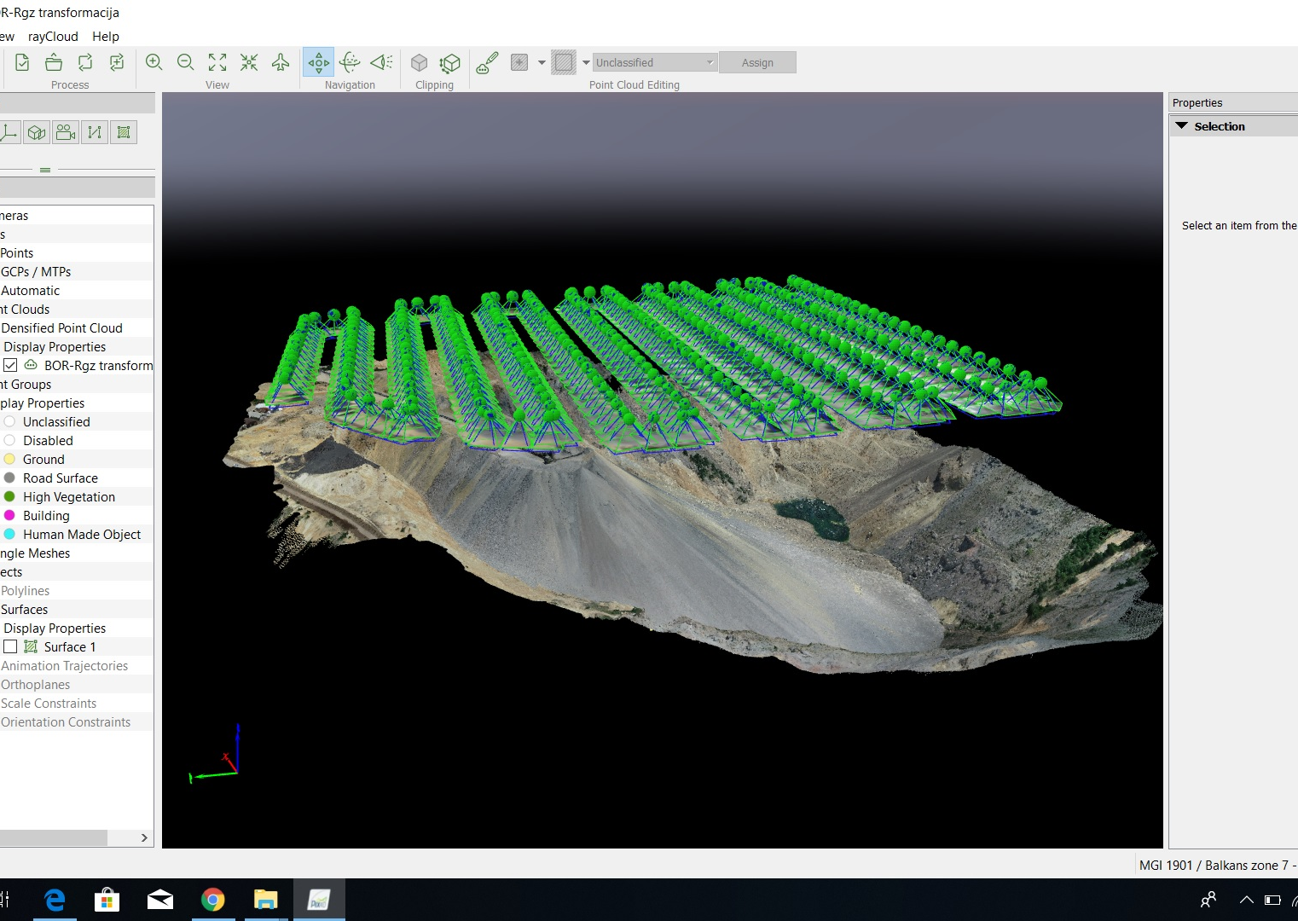
Point Cloud and Mapping Flight Plan

Slide 14
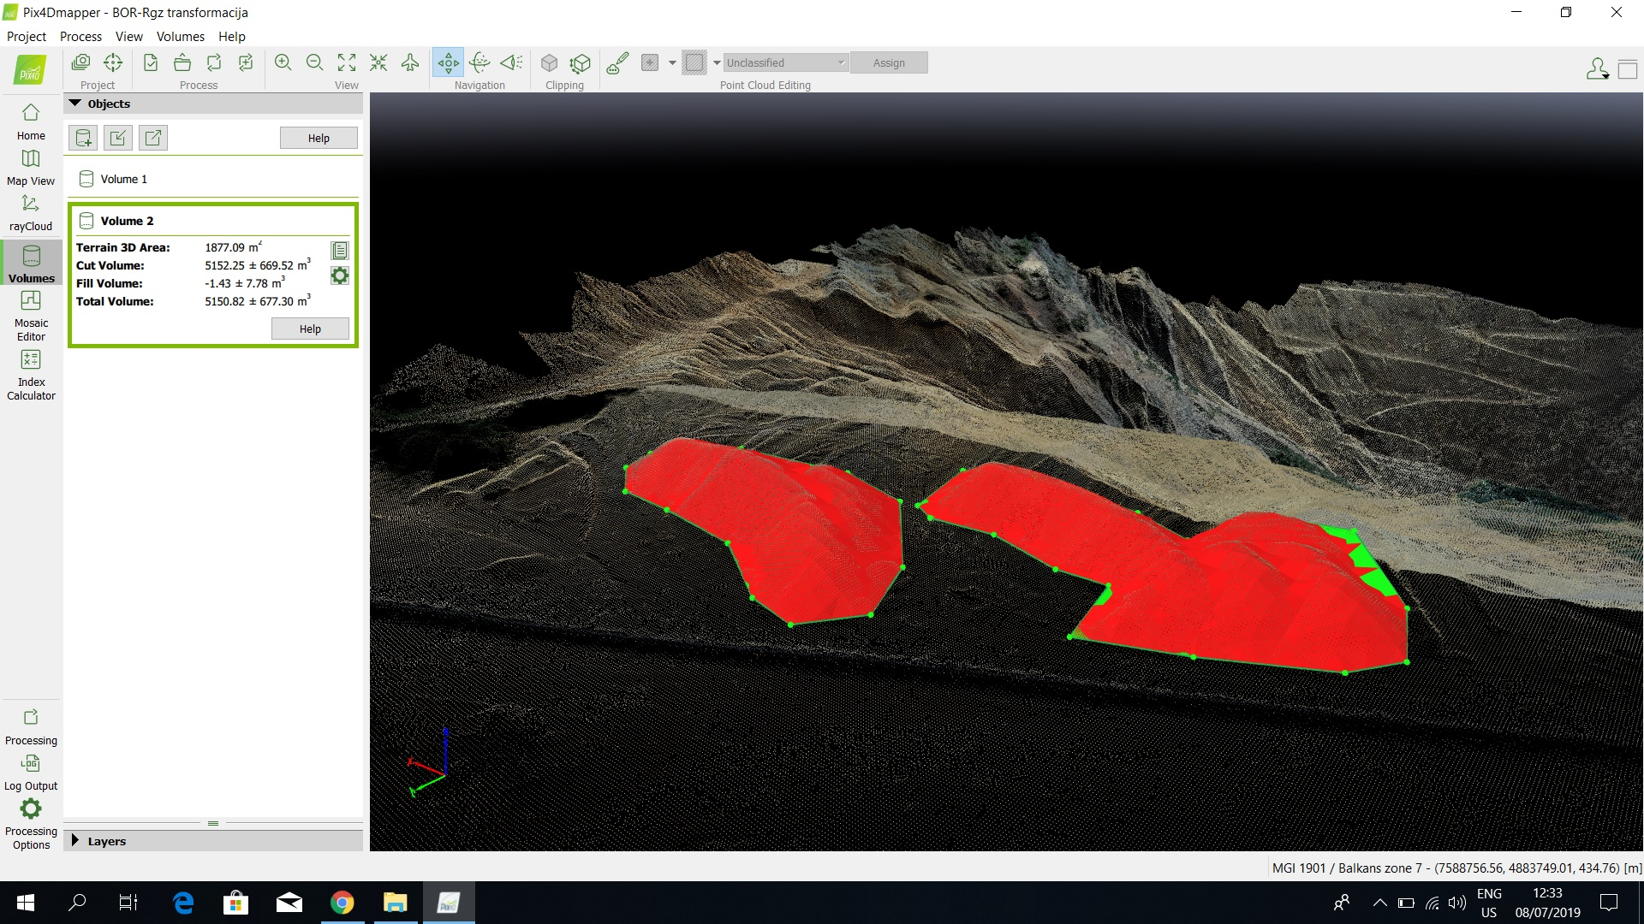
obracun kolicina u trenutku

Slide 15
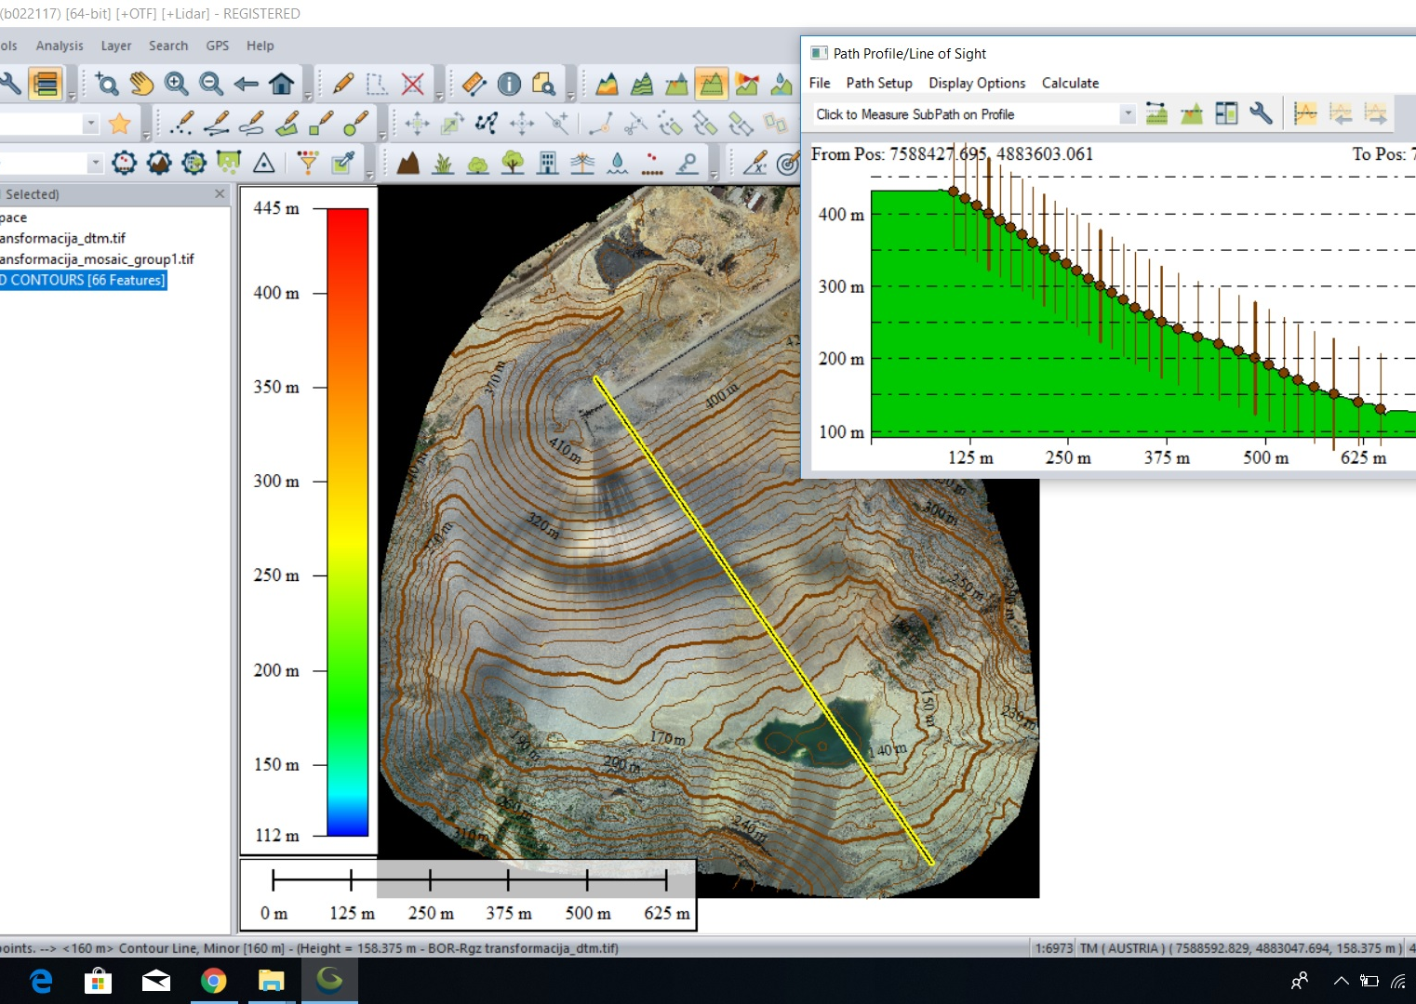
3D terrain contours and transverse profiles

Slide 16

Examples of good practice
Waste Fires in Australia: Cause for Concern https://www.environment.gov.au/protection/publications/waste-fires-australia
Review and Investigation of deep-seated fires within landfill sites
https://assets.publishing.service.gov.uk/government/uploads/system/uploads/attachment_da ta/file/365144/review_and_investigation_of_deep-seated_fires_within_landfill_sites.pdf
Subsurface Heating Events at Solid Waste and Construction and Demolition Debris Landfills https://epa.ohio.gov/Portals/34/document/guidance/gd_subsurface_heating_events.pdf
Causes and Mitigation of Subsurface Heat Accumulation in Landfills https://www.epa.gov/sites/production/files/2016-11/documents/shc_3.63_poster_40.pdf

Slide 17
https://greenes.akademijanis.edu.rs/en

