Slide 1
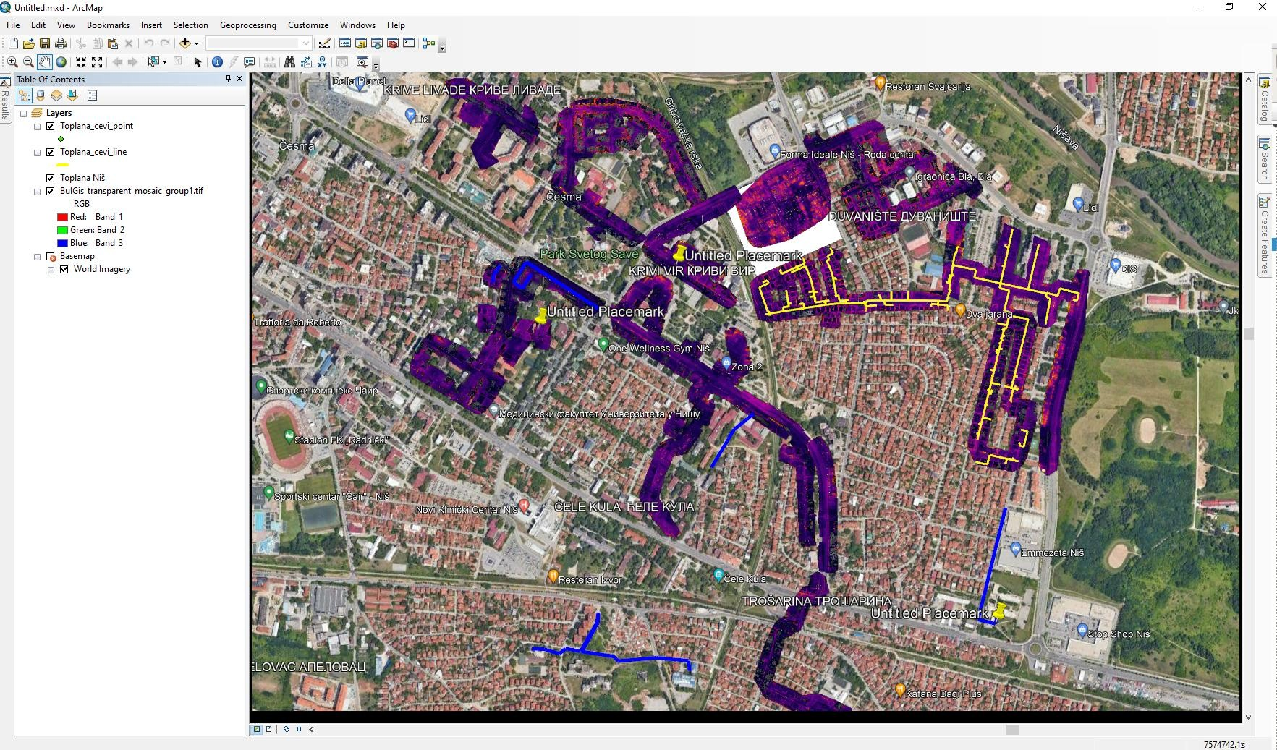


The model of detection of the condition of the thermal pipe network

Slide 2

What do we want to achieve?
Prevention of network failures,
Optimize network states
Saving all kinds of resources
Supporting the digitalization of the system
Support and improvement of the existing cadastre of underground installations
………………………

Slide 3

What do we offer?
Fast fault detection
Thermal network mapping
Georeferencing Network Infrastructure
3D projection
Interactive environment WEB access
Reliability
Improvement of existing DKPs
Wide application of results

Slide 4
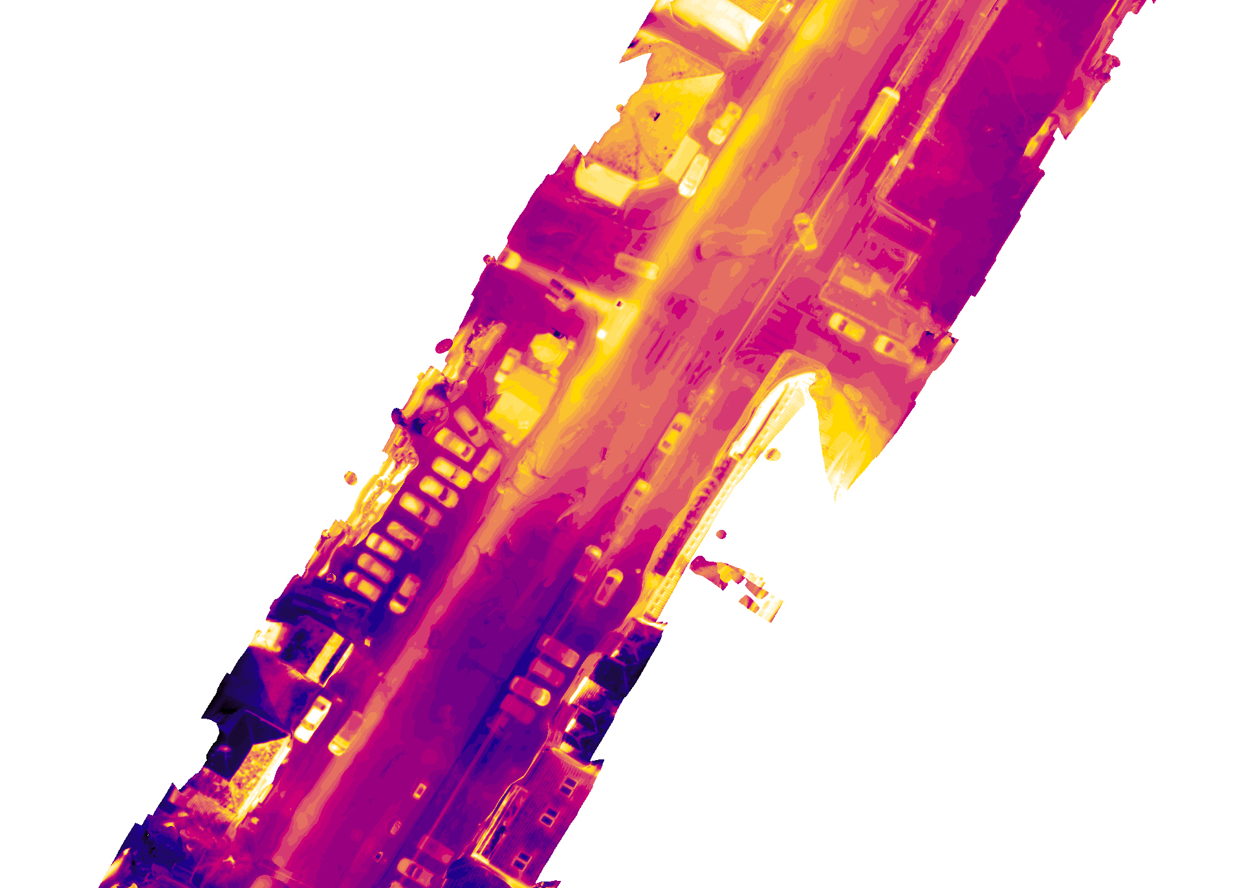
Tools
BPL Matrices 300 RTK
Thermal/Wide Camera for BPL
Thermal analytic tools
THERMAL converter
PIX 4D
GIS
DKP

Slide 5
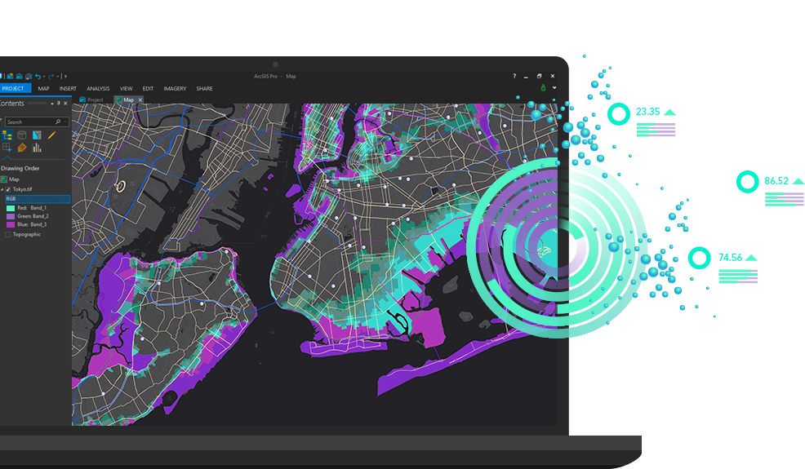
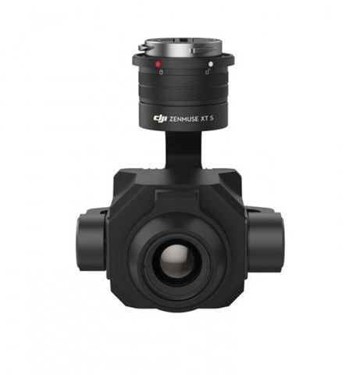

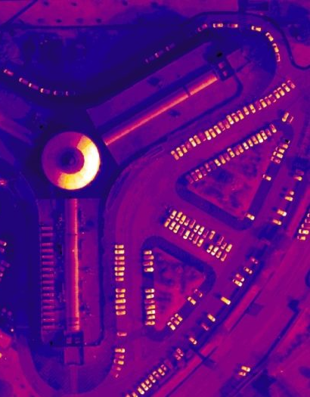
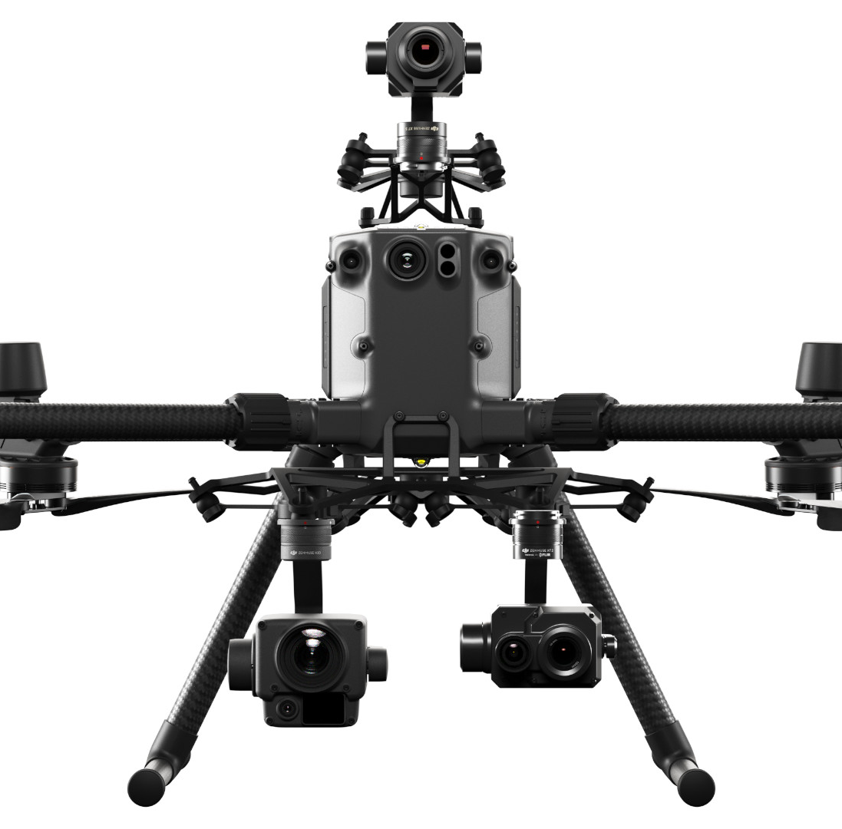
DESCRIPTION OF THE METHOD

Slide 6
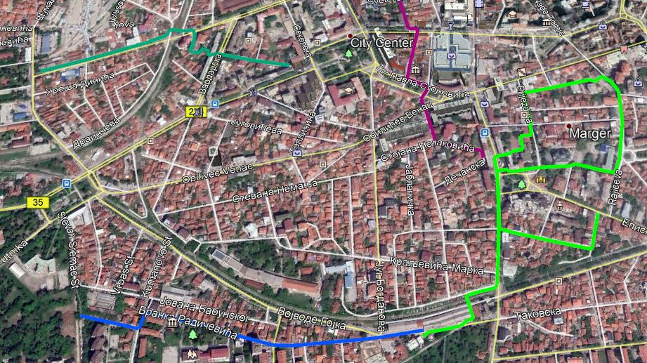
METHOD
Fulfillment of legal obligations
Routing
Overflight, shooting, mapping
Data analysis
Thermal Conversion
Creating orthophoto images and interactive maps
Transformation into GIS and matching with DKP
Delivery of interactive and GIS maps through the WEB portal

Slide 7
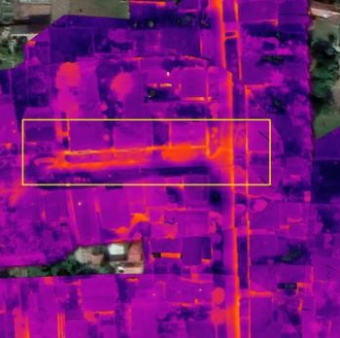
The orthophoto mosaic obtained by processing in the Pix4D Mapper software from the photos taken by the thermal imaging camera of the drone is georeferenced in the coordinate system "WGS 84 / UTM Zone 34N".

Slide 8
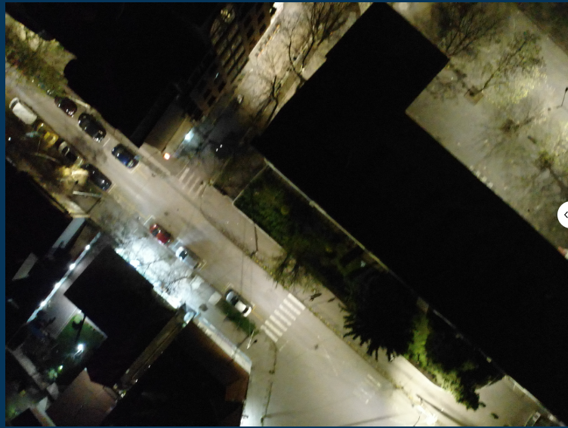
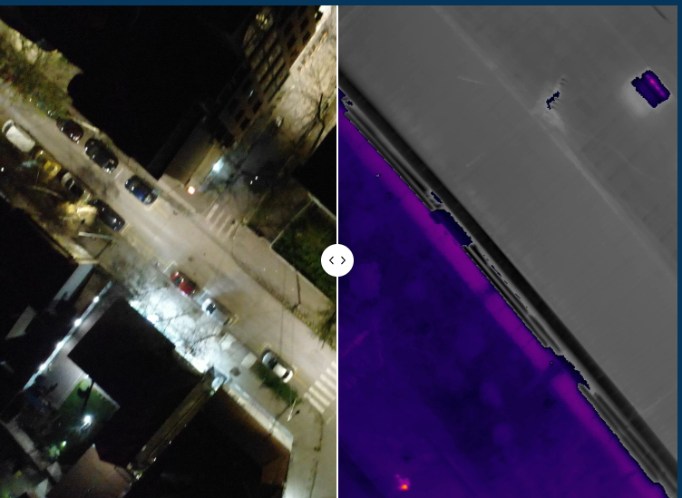
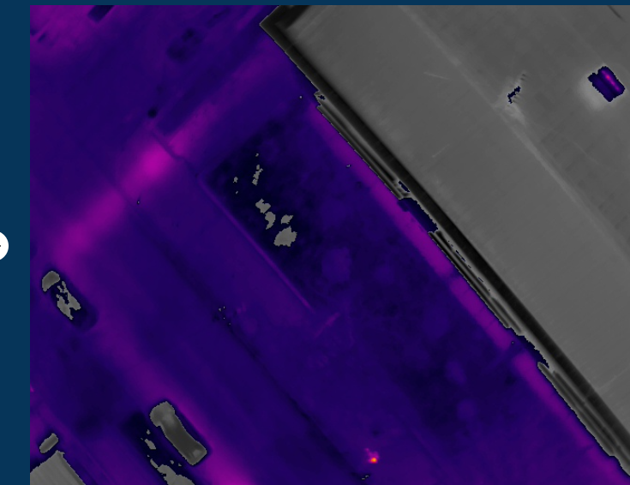
https://greenesen.wordpress.com/komparacija/

Slide 9
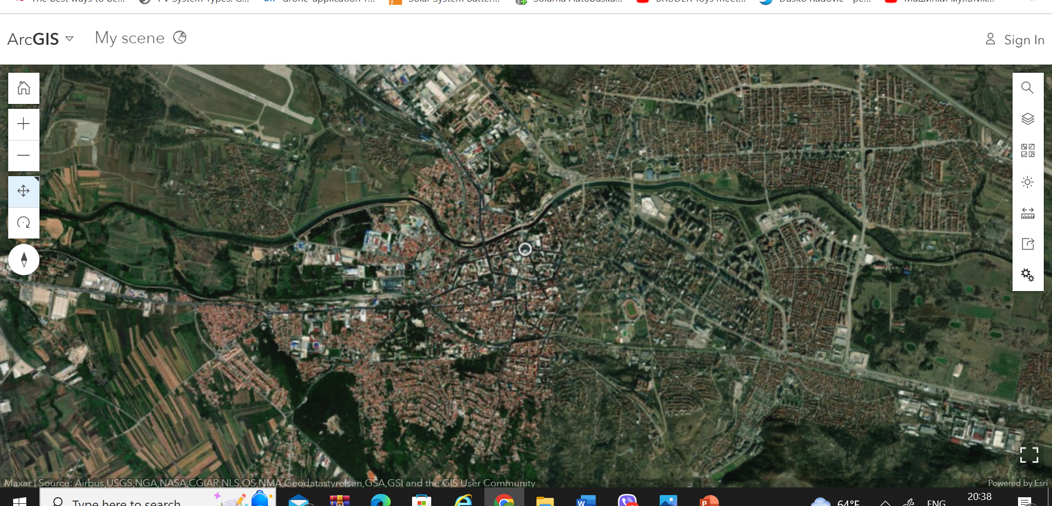
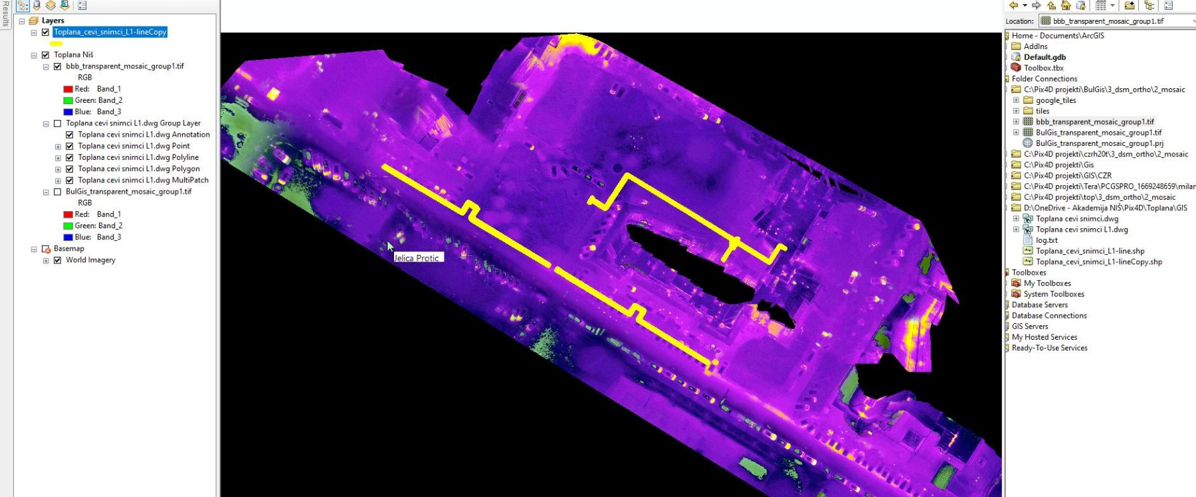
ARCGIS

Slide 10
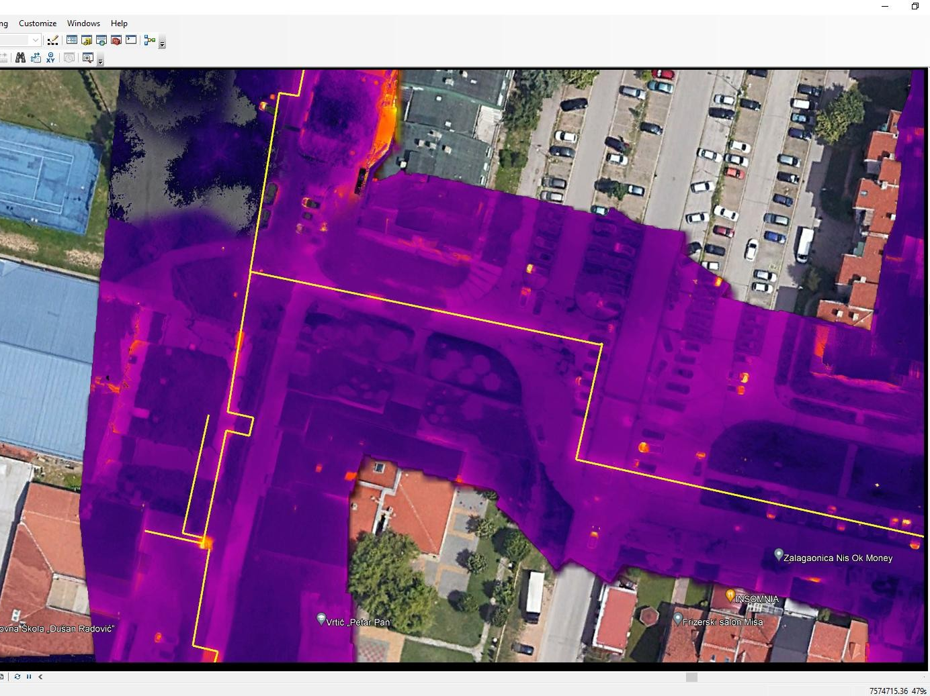

Slide 11
Key partners:
Local authorities and district heating companies as potential customers.
Manufacturers of thermal imaging systems and equipment.
Clients:
Local authorities and administrations that are responsible for the maintenance of hot water networks.
Companies and industrial facilities that use thermal energy from district heating plants.
Managers of buildings and residential complexes that use district heating.

Slide 12
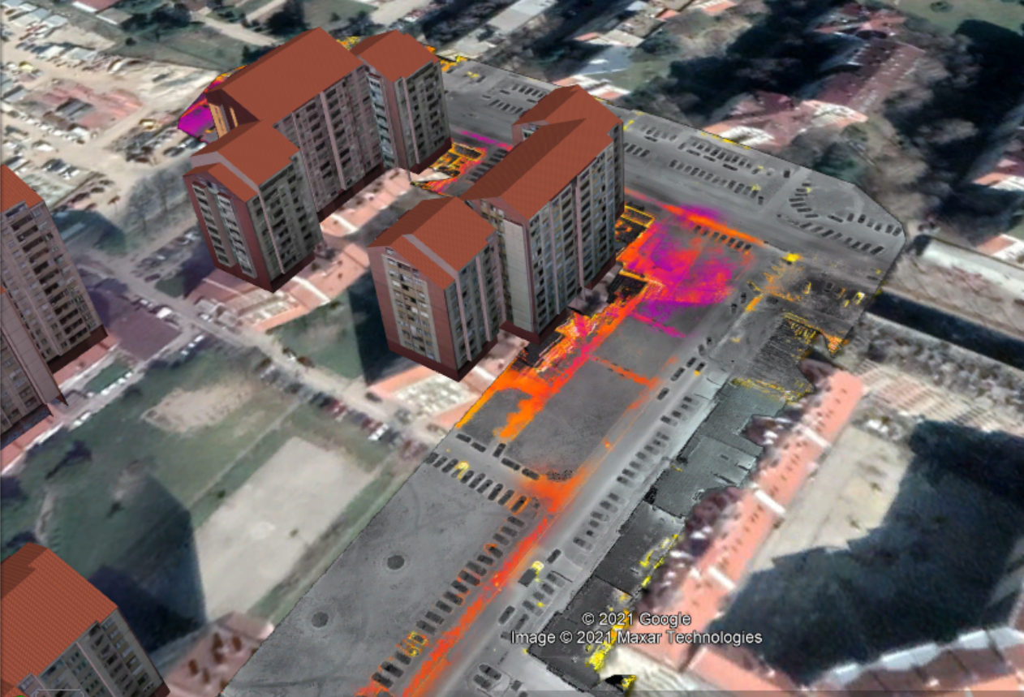
Distribution channels:
Direct sales of services through marketing campaigns, presentations and offers.
Partnerships with real estate maintenance and management companies.
Online platforms for promoting services and contacting potential clients.
Costs:
Purchase and maintenance of thermal imaging systems and equipment.
Salaries of employees and experts in the analysis of thermal images.
Marketing activities and promotion of services.
Administrative costs and operating expenditure.

Slide 13
Revenues:
Charging for thermal map and analysis services.
Offer periodic inspections and maintenance of the system.
Sale of equipment, software and additional services.
MARKET
4000 km of hot water network in Serbia
Xxx km in the Republic of North Macedonia
XXX in the Republic of Slovenia

Slide 14
CONCLUSION
A clear and well-defined thermogram
Improved image quality
Unified Control Programming Environment
Uniform temperature scale,
Compactness and mobility of the thermal imaging system,
Easy handling, reliable results,,
WEB Portal
GIS Interactive Environment and Georeferencing
Matching with DKP

